Slide 1
Genetics – study of genes (specific DNA) Genomics – study of ALL the DNA in an organism

Slide 2
Why genomics?

Slide 3

99.9% Identical
Notes:
Everyone on the planet has a genome. A genome is all the DNA that’s contained in your cells. We’ve discovered that 99.9% of our DNA is identical, or maybe even more than that. So why are we all so different from one another? It’s amazing that such a small amount of DNA results in such large differences. We want to know things like why some people are tall and some are short. Why some get cancer and some don’t. Why some people live to be 100 and some don’t. We suspect that a lot of these things are driven by things in our genomes.

Slide 4
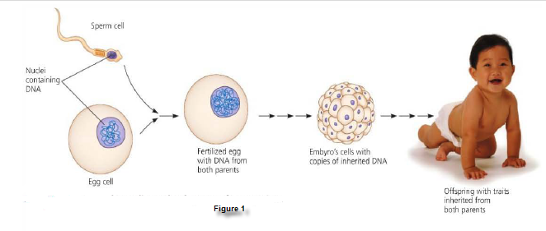
Campbell biology book
Notes:
At a most basic level, our genome encodes how we develop. We start out as a single cell with a copy of DNA from each of our parents. Then that cell divides into an embryo, and then it quickly develops into a whole person! That entire program of development is somehow encoded in out genome and we don’t quite yet understand how it all works. How do cells decide to become a neuron or a skin cell? Genomics might give us some insight.

Slide 5

Notes:
Another area genomics might be relevant is cancer. Normal cells in our body grow, differentiate into different cell types and then die during their normal life cycle. Cancerous cells, on the other hand don’t stop growing and dividing like they’re supposed to. Cancer cells, have the same genetic code, the same genome in them, but somehow they’ve gone haywire. The type of cancer you have is dependent on what type of your cells are dividing without control – what type of cell started the cancer. We already know that some genes make us more likely to get cancer than others.
Maybe there are some other clues in our genome about why cancer happens.

Slide 6
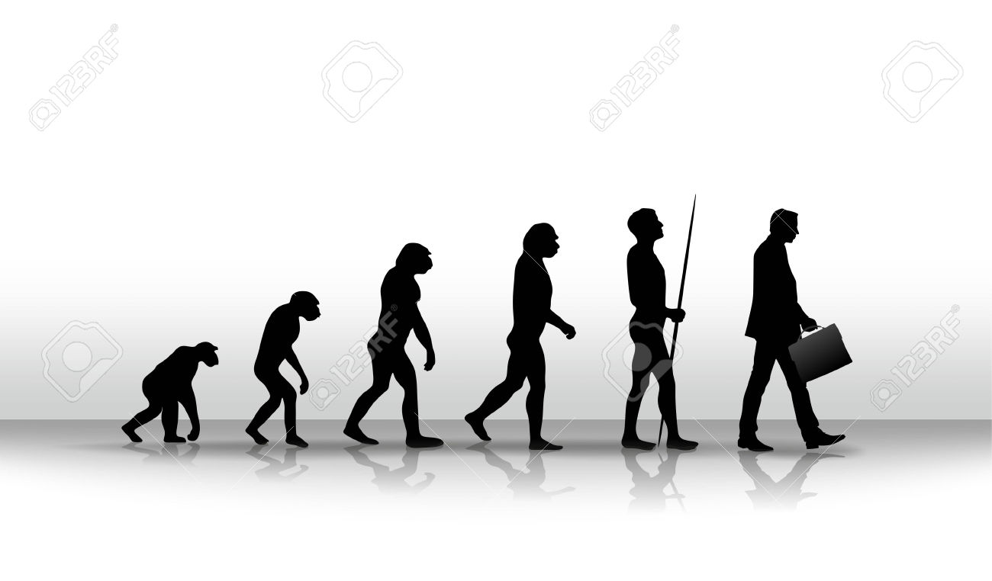
Notes:
Another aspect of genomics is evolution. When we talk about the evolution of genomes, we’re talking about hoe genomes themselves change over time. We know that most human genomes are nearly identical to one another. Most of the differences that exist are due to small random changes called mutations. While most of these mutations don’t have any effect, some of them do! We can compare our genome to lots of other creatures and we find that we share a surprising amount of sequence, even with things like bacteria. Back in the day, people would study just one gene and try and figure out what it did. Now we can look at lots of genes at once and try and understand how lots of genes work simultaneously.

Slide 7
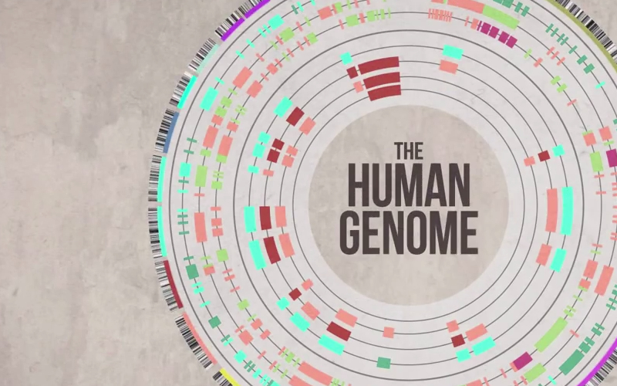
Notes:
A lot of the field of modern genomics grew out of the human genome project. It was completed in April 2003 and gave us the ability, for the first time to read the genetic blueprint for building a human being. It took about 13 years for us to sequence the entire genome and we discovered that humans have about 25,000 genes. After we sequenced humans, we started doing a bunch of other animals. Mice, cows, etc. The first project cost around $30 million to sequence. After people started doing sequencing more and more, the cost started to frop. Now it costs about $1000 to sequence a human genome. That makes it possible for us to do a lot of experiments we couldn’t do before!

Slide 8
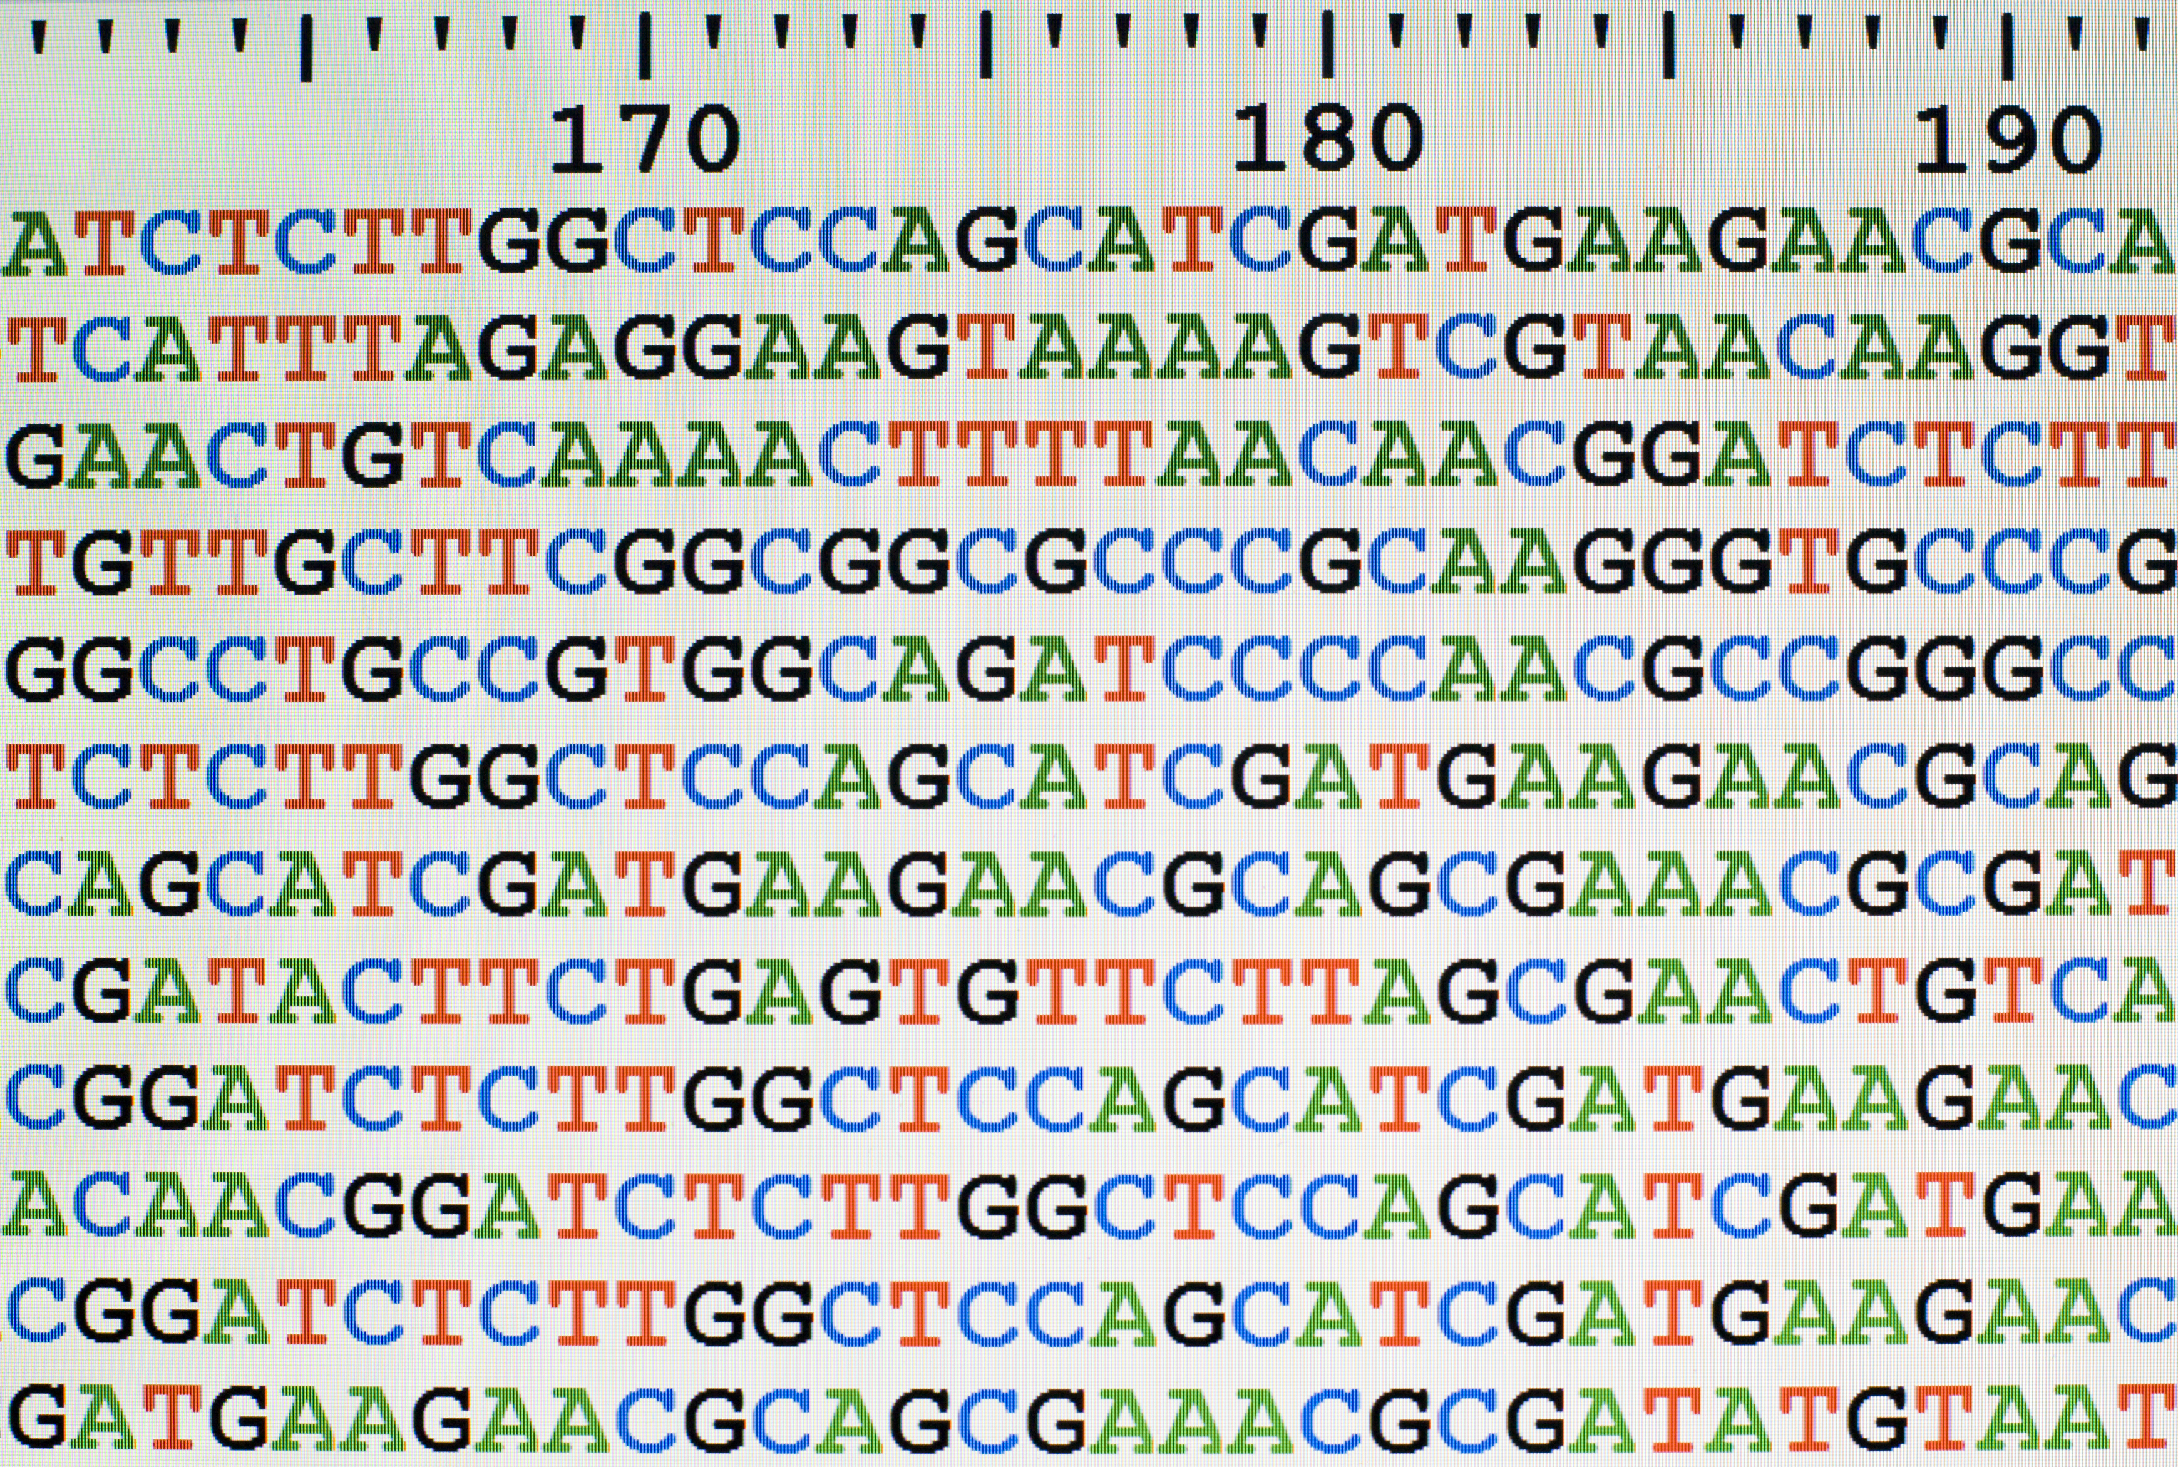
Notes:
Now that we have so much data, we have to think about what to do with it and how to study it. There are lots of data scientists that study the genome. We call that discipline genomic data science. That’s basically how we can combine statistics, microbiolgy, and computer science to learn a lot of information we didn’t know before. Genomic data scientists have to be smart about what they’re doing. They have to figure out what kind of data they want to collect and how. These experiments take a lot of time, and while they now take less money they can still be expensive. Then once they do their experiment they end up with a lot of data. Sometimes that data isn’t perfect. There can be error in reading DNA. So we have to figure out some ways that we can correct those errors. We’ll talk about this more in the class.

